Slide 1
ENR1 – SCH1 Quality Scenarios
Milestone 2, NSWI130, 2024
ENR1 – Matyáš Černíček, Jan Čelovský, Šimon Jůza, Jan Růžička, Vojtěch Snop, Rastislav Vojtuš

Slide 2
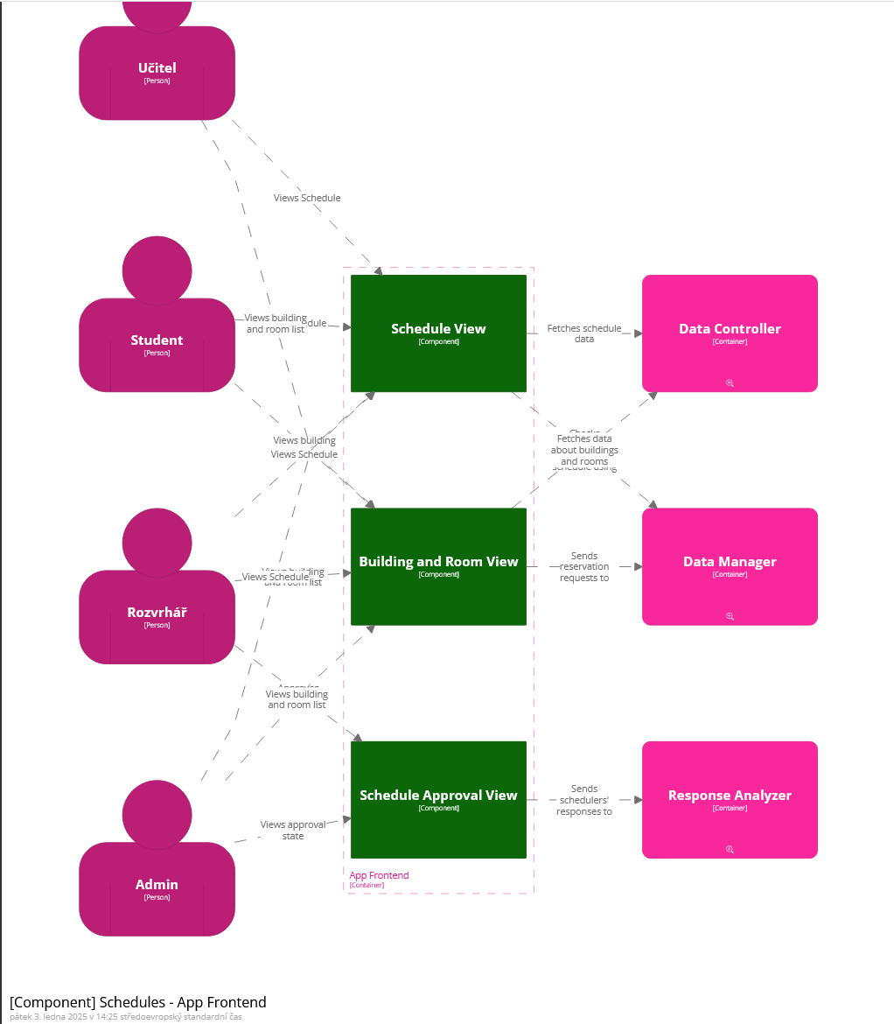
App_Frontend

Slide 3
Quality requirement scenario 1 – App Frontend
Run-time dimension - Security
Source: Attacker/Hacker
Stimulus: wants student and school data
Artifact: AppFrontend (to Data Controller)
Response: Attacker's script/hack is not accepted and is blocked from the system
Measure: The data is untouched
Architecture update
Based on this scenario, the AppFrontEnd container should have an extra "Entry point" component that deals with script injections and unauthorised access.
Also makes the diagram more readable.
Šimon

Slide 4
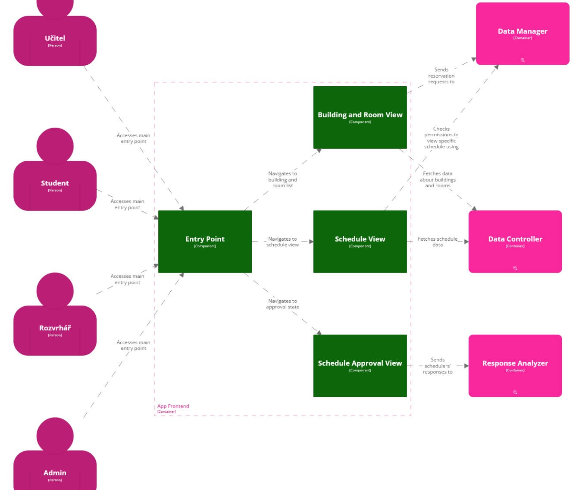
new
App_Frontend

Slide 5
Quality requirement scenario 2 – App Frontend
Design-time dimension - Modifiability
Source: App Frontend - Building and Room View
Stimulus: New rules for reservations are to be added
Artifact: Data Manager
Response: New reservation rules are added and working
Measure: 5 man-day of testing
Architecture update
The architecture should be able to handle it.
Container - Data Manager contains neccessary "checker" components.
A more localized approach may be beneficial to simplify this process.
Vojtěch

Slide 6
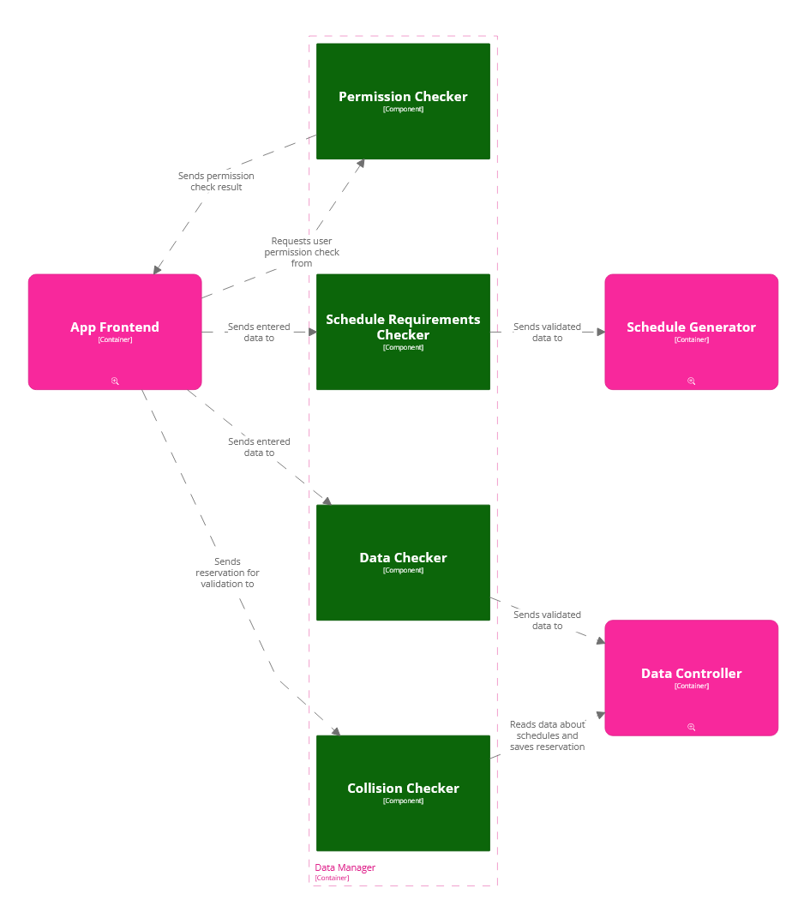
Data Manager

Slide 7
Quality requirement scenario 3 – Data Manager
Run-time dimension - Availability
Source: App frontend
Stimulus: sends wrong data to validate
Artifact: Data manager - schedule requirements/data checker
Response: informs the app frontend
Measure: 1 second
Architecture update
The architecture should inform app frontend about what was wrong with input data.
Create two-way communication between App Frontend and Datachecker component
or consider expanding architecture by component "info sender" that would better communicate with front end.
Matyáš

Slide 8
new
Data Manager
Sends back data if wrong

Slide 9
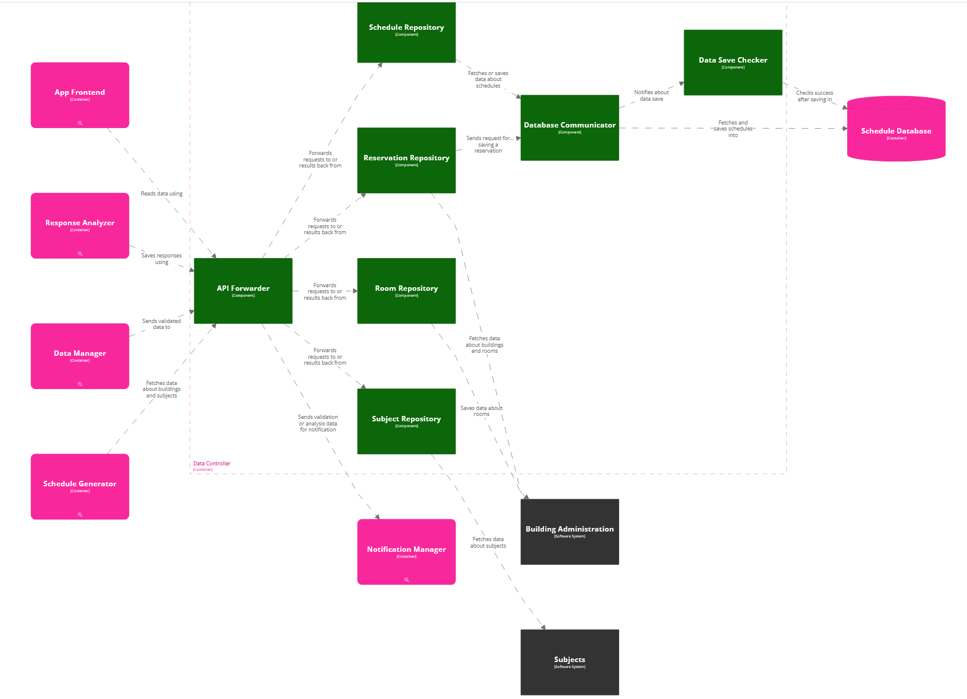
Data Controller

Slide 10
Quality requirement scenario 4 – Data Controller
Run-time dimension - Performance
Source: Student
Stimulus: Displays information about buildings and schedules (500 requests per minute)
Artifact: Data controller
Response: All requests processed
Measure: With an average latency of 500 ms
Architecture update
The architecture should be able to handle it.
All request are handled by data controller succesfully, so there is no need for a change.
Rastislav

Slide 11
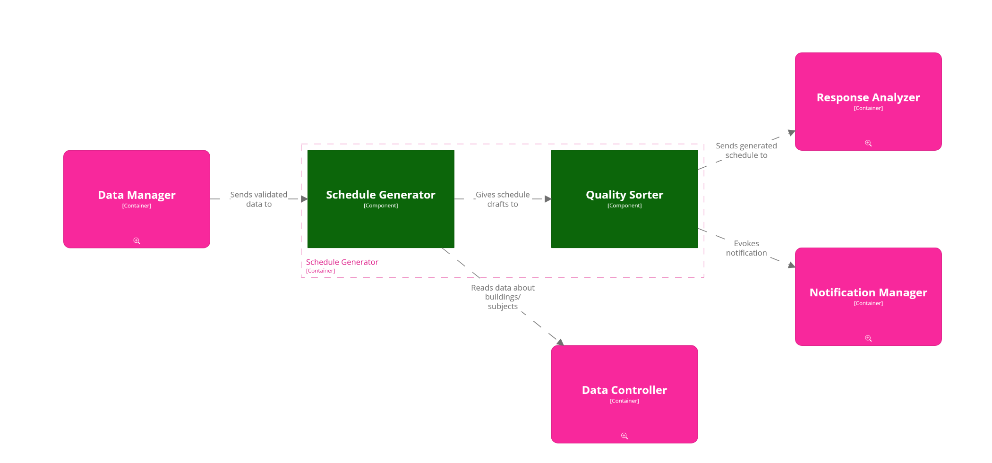
Schedule Generator

Slide 12
Quality requirement scenario 5 – Schedule Generator
Run-time dimension - Performance
Source: Schedule Generator - Generator Component
Stimulus: Generated schedule for quality evaluation
Artifact: Quality Sorter Component
Response: Apply sorting rules and refine generated schedule
Measure: 5 seconds
Architecture update
The architecture should already apply sorting rules when creating the schedule, which can be resolved by merging the two components.
This will lead to faster scheduling than doing 2 operations separately - generating and sorting.
Jan R.

Slide 13
NEW Schedule Generator
Schedule Generator
[Component]

Slide 14
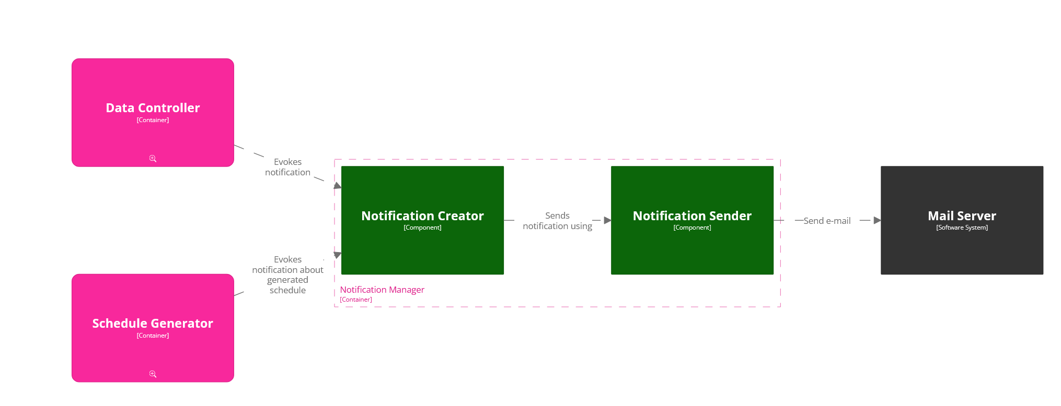
Notification Manager

Slide 15
Quality requirement scenario 6 – Notification Manager
Design-time dimension - Modifiability
Source: Notification Manager
Stimulus: New mail server to be used
Artifact: Mail server
Response: New mail server is added
Measure: 1 man-day of testing
Architecture update
The architecture should be able to handle it.
Notifications are just sent to a different mail server.
Jan Č.

Slide 16
Notification Manager
NEW MAIL SERVER

Slide 17
Thank you for your attention!

